Slide 1
Local contexts and impact on women: NREGA in Kerala, Himachal
Ratna M. Sudarshan, Director, ISST
(on behalf of ISST team)
IHD Seminar on NREGA and Women’s Empowerment, 31 August 2009

Slide 2
Work days generated: share going to women

Slide 3
Total work days – women, by state

Slide 4
Share of person days to women (%) 2007
Share of Person days to Women (%) 2008-9

Slide 5
Variations observed across states and also within states in the percentage of work days going to women

Slide 6
Districts in Kerala: women’s share in work days by district

Slide 7
Days claimed by women, Palakkad district, Kerala

Slide 8
Palakkad: No of women/ total individual applicants
Kerala – variations within Palakkad district

Slide 9
Himachal: district wise variations in %age of women work days

Slide 10
Women’s share in employment generated, Sirohi Rajasthan

Slide 11
Wages and systems of payment

Slide 12
Wages
Wages paid = min. wage in Kerala, Himachal
Market wage for men> min wage - little impact on male migration
Market wage for women well below min. in Kerala – NREGA a welcome opportunity: some evidence of upward pressure on women’s market wages

Slide 13
Malampuzha, Palakkad. Kerala. Average wage paid (min wage 125)

Slide 14
Himachal – average wage paid (Min Wage Rs 100)

Slide 15
Time rate or piece rate
Payment patterns vary – Kerala, Himachal, payment is for number of days worked * min wages
In Rajasthan, computed as [value of completed work/ no of workers on muster roll] so actual earnings below min. wage; however trend increase over time

Slide 16
Sirohi, Rajasthan – average wages paid (Min Wage Rs 100)

Slide 18
Management on worksites

Slide 19
Local Contexts: Kerala
Management of worksites entrusted to Kudumbashree (state poverty eradication mission)
Area Development Supervisor (women) maintain muster rolls, etc. Typically educated, between 32-45 years, attends a minimum of 10 meetings a month.

Slide 20
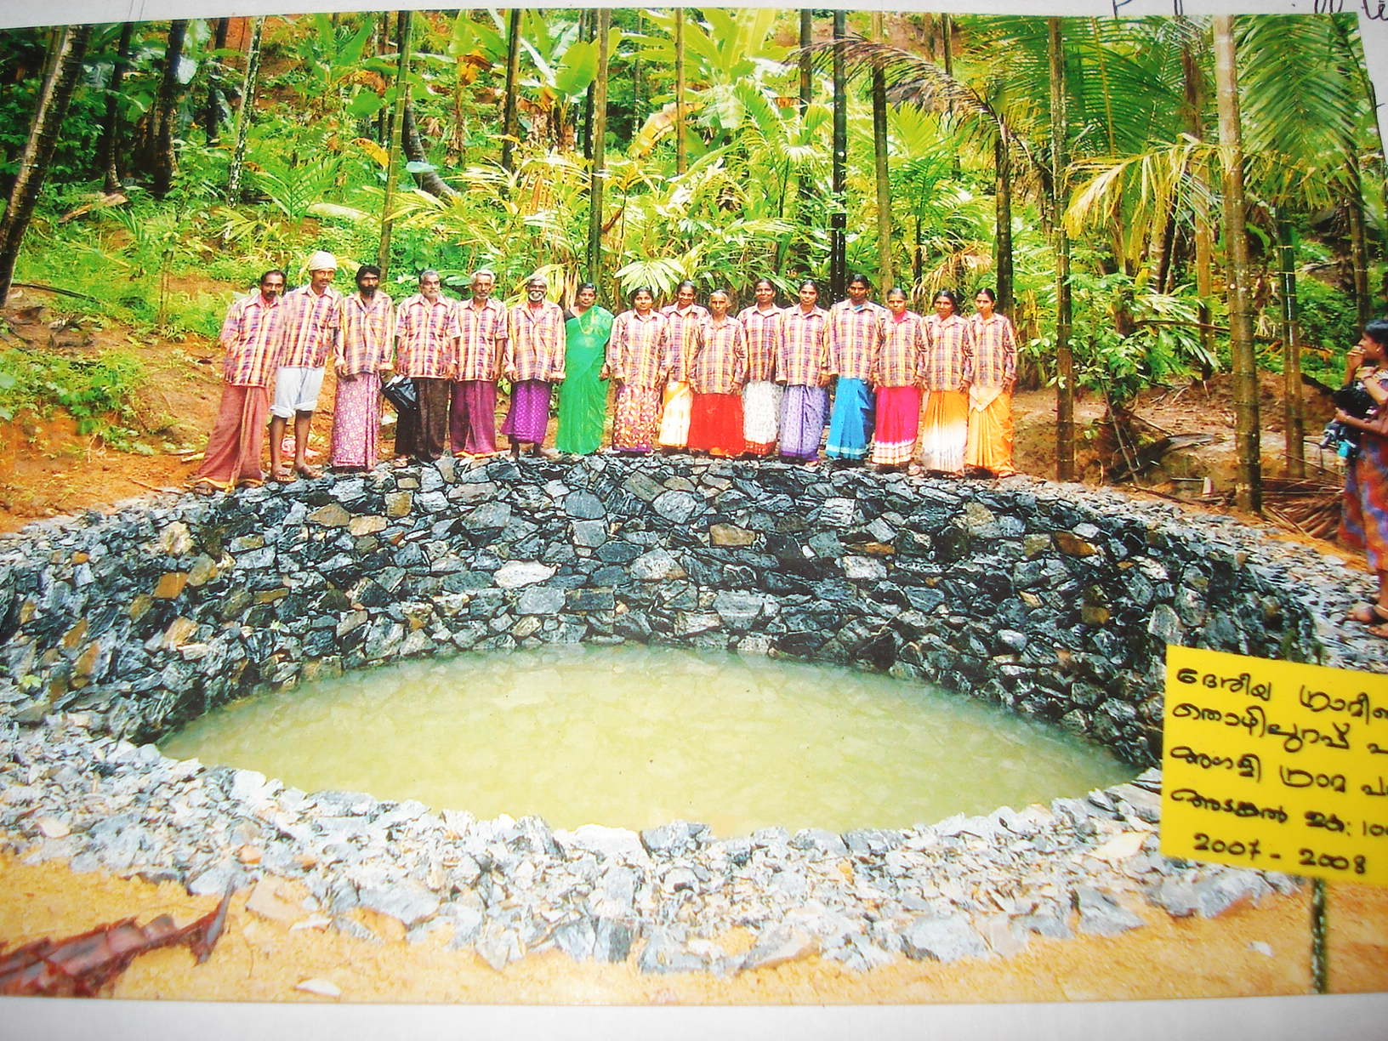
ADS in charge of whole group

Slide 21
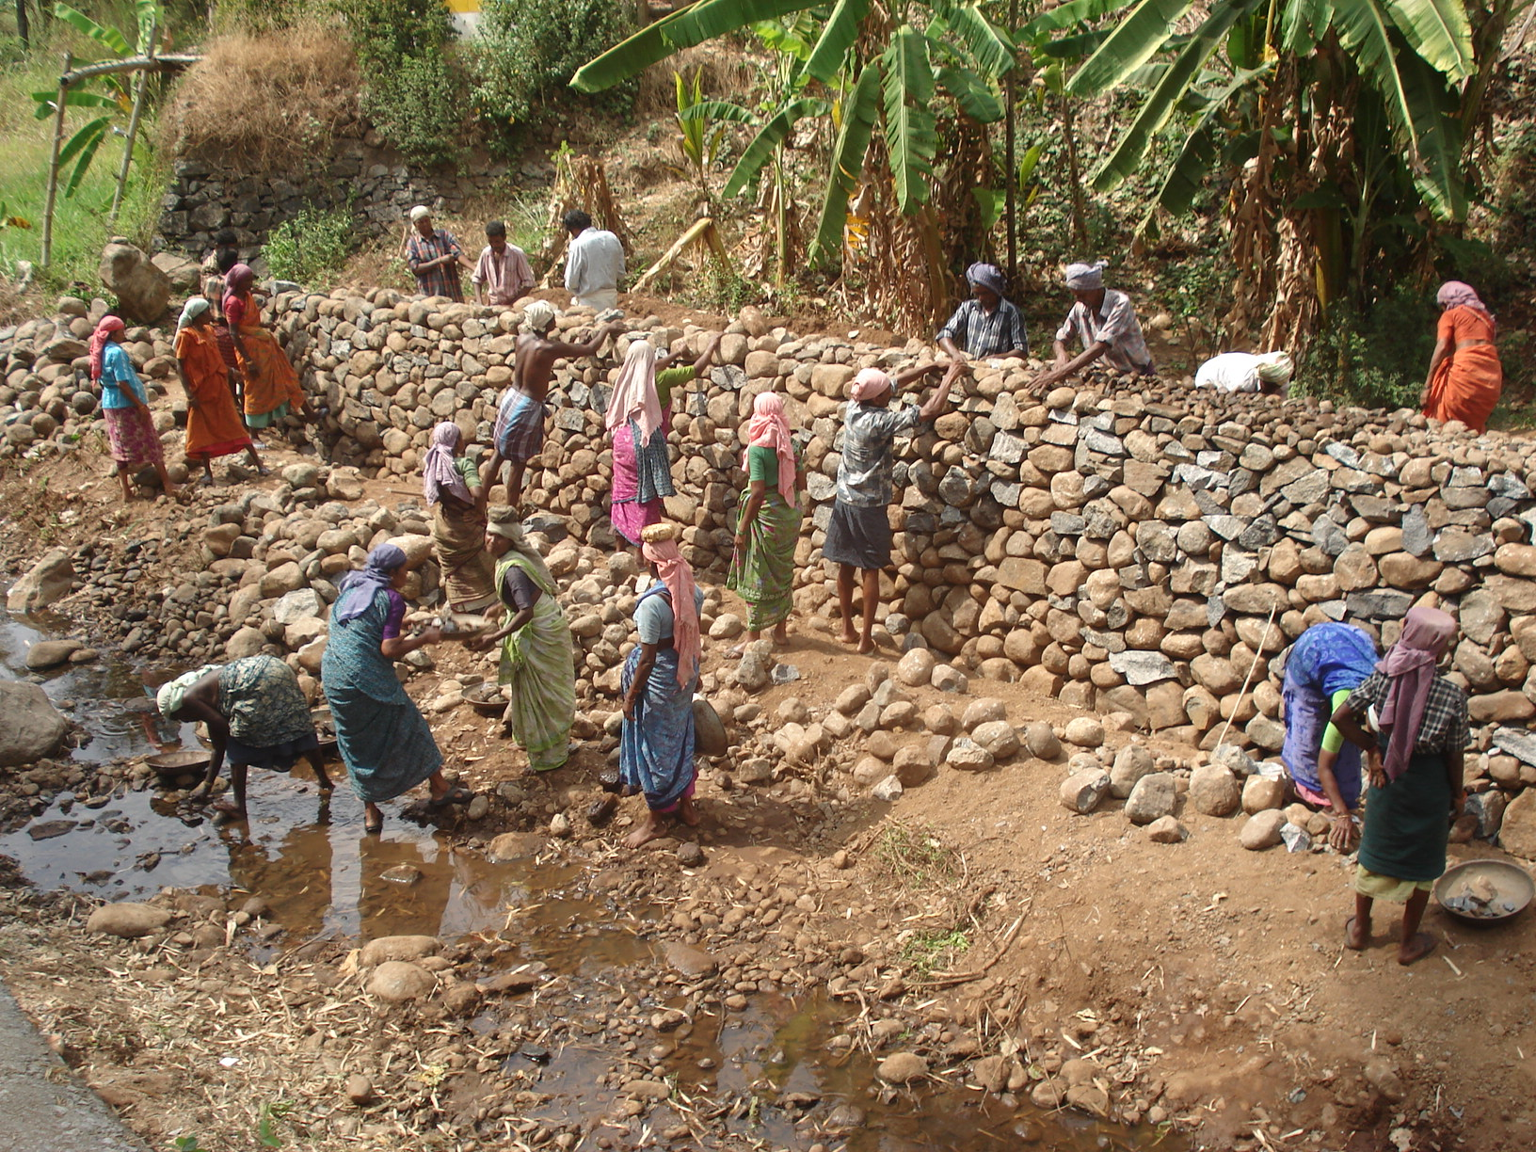
Kerala

Slide 22
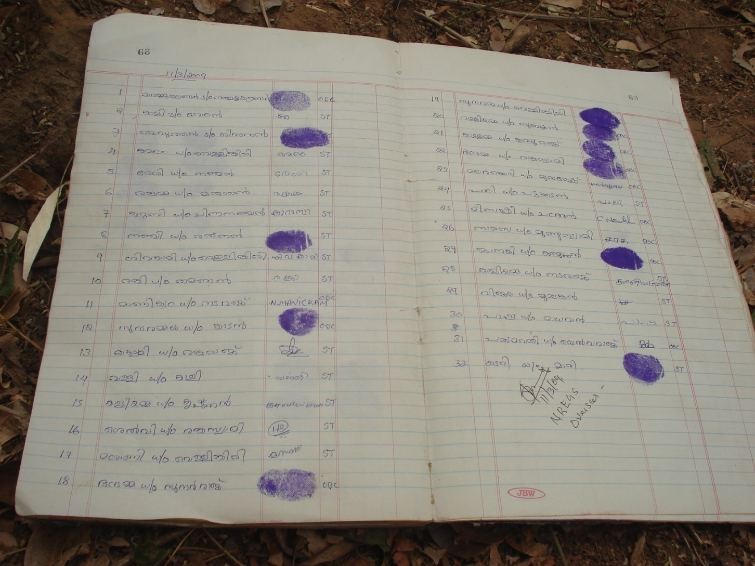
Muster roll, Kerala

Slide 23
Local Contexts: Kerala
But even with good management systems, some participate much less
  Young women with young children (< 30 years)
  Tribal areas – Attapady –
    difficult to mobilise into groups,
    distance to site greater,
    activities not always suitable to area;
    formation of Kudumbashree ‘adivasi only’ groups in progress

Slide 24
Involving women
Kudumbashree groups are an exception – strong management, women’s groups, embedded in panchayat structure
Himachal: eg Sangrah village; Sangrah panchayat: Long established mahila mandal not active participant in NREGA
Possibility of partnerships between panchayat and independent groups??

Slide 25
Assumptions in the design
The NREGA Guidelines recommend districts to draw up a 5 Year Perspective Plan, based on annual shelf of works assembled by panchayats and consulting with gram sabha.
More often than not, panchayats lack technical knowledge; Civil engineers do not participate here; Women do not attend or participate in the gram sabha.

Slide 26
Nature of Works – potential development impact

Slide 27
Development Impact
Beyond wages and a cash transfer to households, development impact requires building upon local context
Kerala, Rajasthan – tradition of wage work by women – question becomes one of identifying most needed works
Himachal – tradition of self employment on own farms – and coming together over shared natural resources

Slide 28
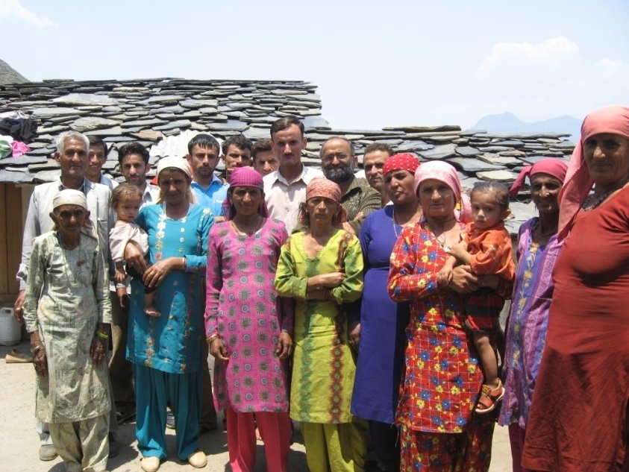
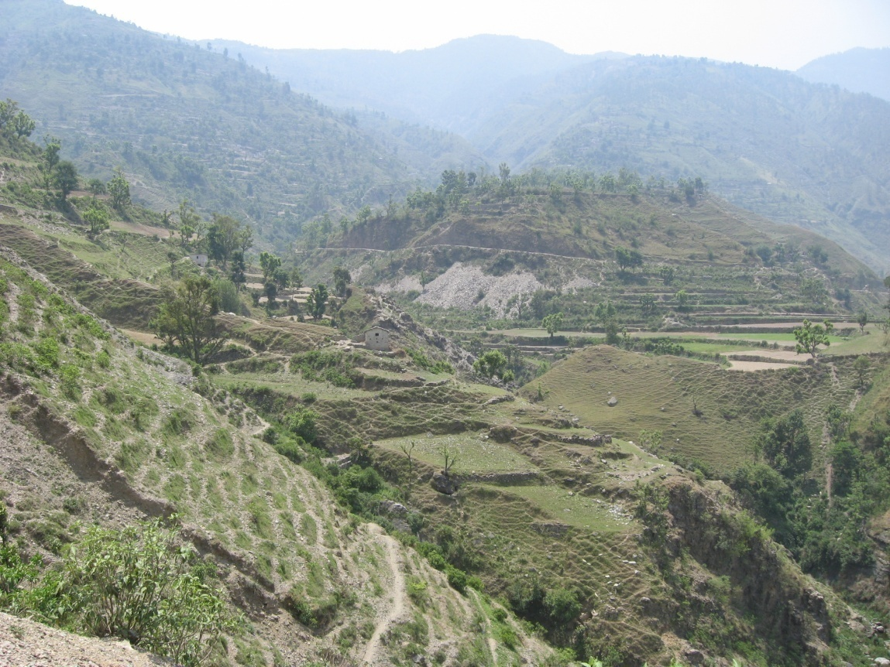
Trenches created under NREGA will arrest soil erosion and retain water: however, should such trenches be cemented?
Drabil village, Drabil panchayat; block Shillai; district Sirmour:
.

Slide 29
Development trajectories: complementary, competing?
Ganog panchayat, block Sangrah, district Sirmour:
Open cast limestone mining, besides wreaking havoc on crops, water bodies and forests, has also aggravated alcoholism and violence.
Gully plugs and tanks under the NREGA proceeds alongside.

Slide 30
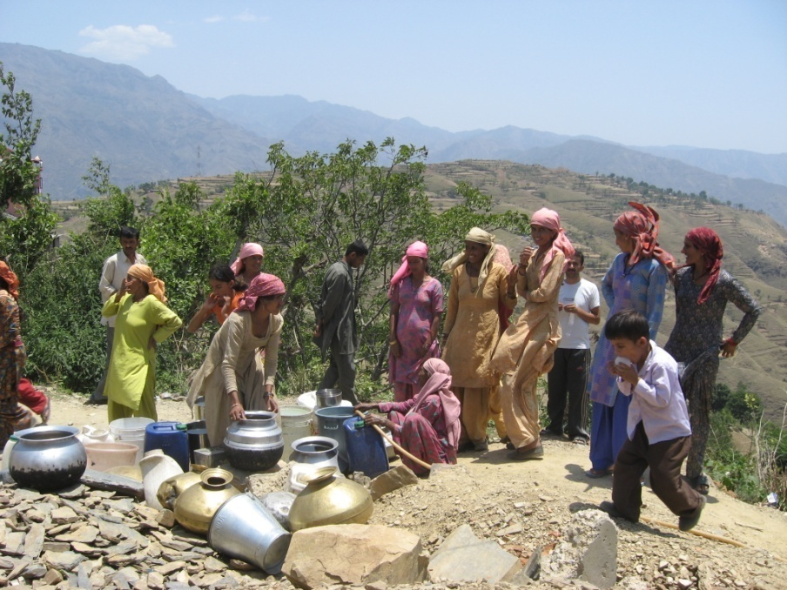
One India, One NREGA?
Developmental needs across the country are not uniform. In Himachal Pradesh, ownership of land is high and livelihood strategies are a combination of rain fed agriculture, livestock and seasonal migration.
Women, increasingly responsible for agriculture, are squarely facing the brunt of ecological degradation.
In Himachal Pradesh, it is asset creation and the eco-restorative essence of the NREGA (rather than wage employment) that resonates loudest.
In Kando (Kando Bhatnol panchayat, block Shillai, district Sirmour), women queue up beside the solitary functioning tubewell (below). Other taps and streams in the village had run dry. It was June but the monsoons were late. Women spent an average of seven hours every day foraging for fuel wood and fodder in the sere brown hills.

